Slide 1
SQL Server Hybrid Cloud Scenarios
SQL Development
Management Portal
Publish
Compare
Sync
Import / Export
Register / Unregister
VPN
Dispersed Teams
Microsoft Azure
SQL Backup/Recovery
Management Portal
SQL Backup tool for legacy
Manual Console Backup
Managed Backups
VPN / Encrypted Data
Microsoft Azure
SQL Business Continuity
Primary
Asynchronous Commit
Secondary
Disaster Recovery
Backup
Availability Groups
Periodic Snapshots
Geo Replication
VPN
Console 2014 / Scripts 2012
Powering BI Apps
Microsoft Azure
Notes:
Microsoft Azure Active Directory is a comprehensive identity and access management cloud solution. It combines core directory services, advanced identity governance, security and application access management. Microsoft Azure Active Directory also offers to developers an identity management platform to deliver access control to their applications, based on centralized policy and rules. For enterprises with more demanding needs an advanced offering, Microsoft Azure Active Directory Premium, currently in preview, helps complete the set of capabilities that this identity and access management solution delivers.

Slide 2
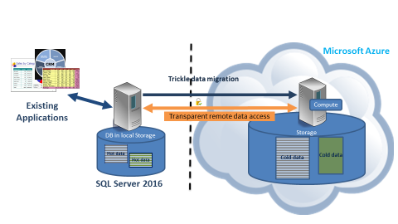
SQL Server Stretch-database

Slide 3
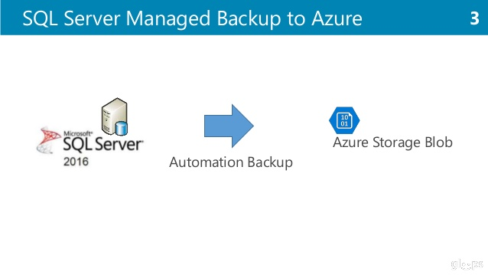
SQL Server managed backups to Azure

Slide 4
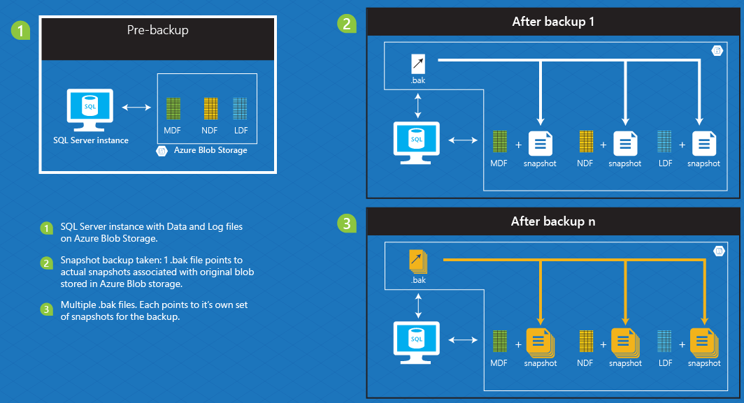
Enhanced Backups to Azure
File-Snapshot
Backups - Mechanism
From MSDN

Slide 5
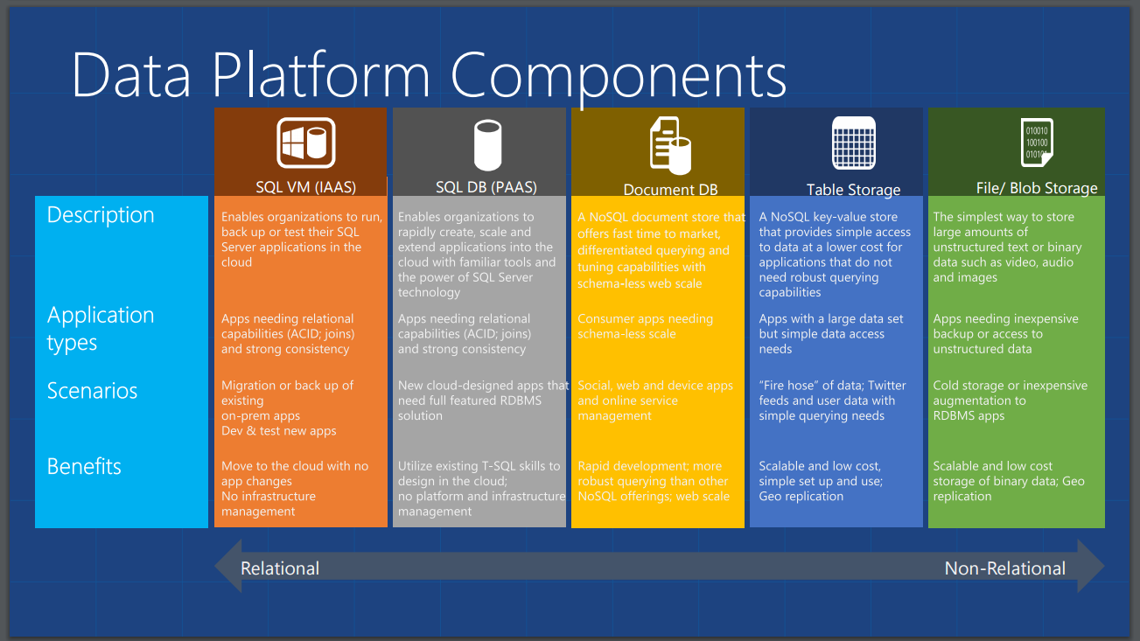
From MSDN

